Slide 1
Data visualization & Analytics
Project -1-Crunch-Team

Slide 2
Safety Moment
In Case of a Fire – Who knows where the stairs are?
Answer: Go out the door , turn to the right and
stairs are immediately on your left.

Slide 3
Team Member Introductions
Fernando Figueiredo
Christopher Guthrie
Rachel Teigen

Slide 4
Our Project -Startups
Startup behind ridiculed $400 juicer shuts down
It turns out that selling a $400 Internet-connected juicer isn't a recipe for success after all.
Juicero, a startup that was widely ridiculed for selling an absurdly overpriced juice machine, is shutting down. The news was announced on its website Friday.
The company had raised about $120 million in funding from multiple prominent investors, including Google Ventures and Kleiner Perkins. Juicero's stated goal was to change how we consume fresh, organic foods.
From www.CNN.com - Article by Seth Fiegerman @sfiegerman

Slide 5
Data Gathering – User interface
User interface for search/queries ($)
Graphical user interface to search and build queries
Companies.csv
Funding_rounds.csv
Organization.csv

Slide 6
Data Gathering – API interface
print("The Crunchbase API responded with: " + json.dumps(org_json, indent=2) + ".")
org_df = pd.DataFrame()
org_df["name"] = "“
oname = org_json["data"]["items"][i]["properties"]["name"]
org_df.set_value(index, "name", oname)
Issues with accessing all json structures – Crunchbase support was no help!

Slide 7
Data Gathering – Screen Scraping
browser.visit(t_url)
time.sleep(20)
soup = BeautifulSoup(html, "html.parser")
Print(soup.prettify())
for line in soup.findAll(‘Html tag’, class_=‘engagement value’)
org2_df.set_value(index, "Total Visits", line.get_Text())

Slide 8
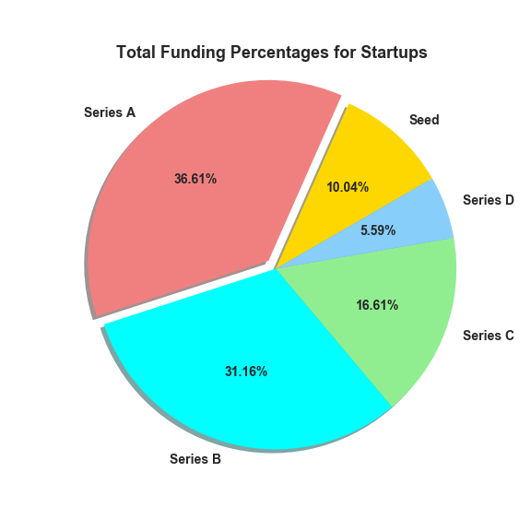
Total Funding Percentages by Type

Slide 9
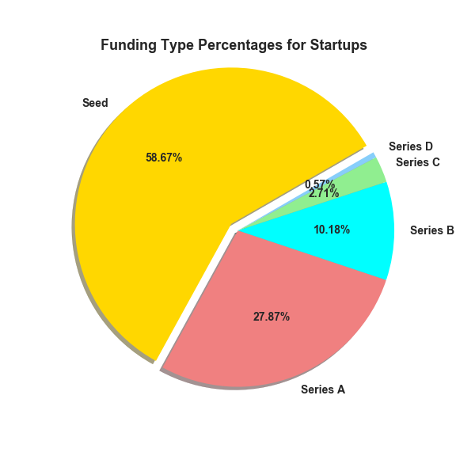
Funding Type percentages

Slide 10
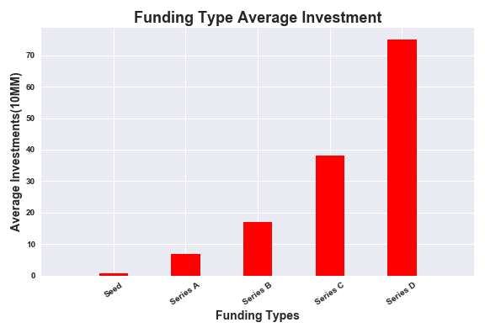
funding Type Average Investment

Slide 11
Lessons Learned
Group Dynamics - Bruce Tuckman said that “teams go through 5 stages of development: forming, storming, norming, performing and adjourning”.
Communication
Planning
Brain Storming
Questions to ask and explore
What charts with what data
Distributing
Storing and Sharing files

Slide 12

Questions

Slide 13
Appendix
Rachel had the idea when we needed one.
www.Crunchbase.com – user interface and API
www.similarweb.com – Web scraping information
www.google.com – search and file storage/sharing
www.github.com - File storage/sharing
https://www.crummy.com/software/BeautifulSoup/bs4/doc

